Slide 1
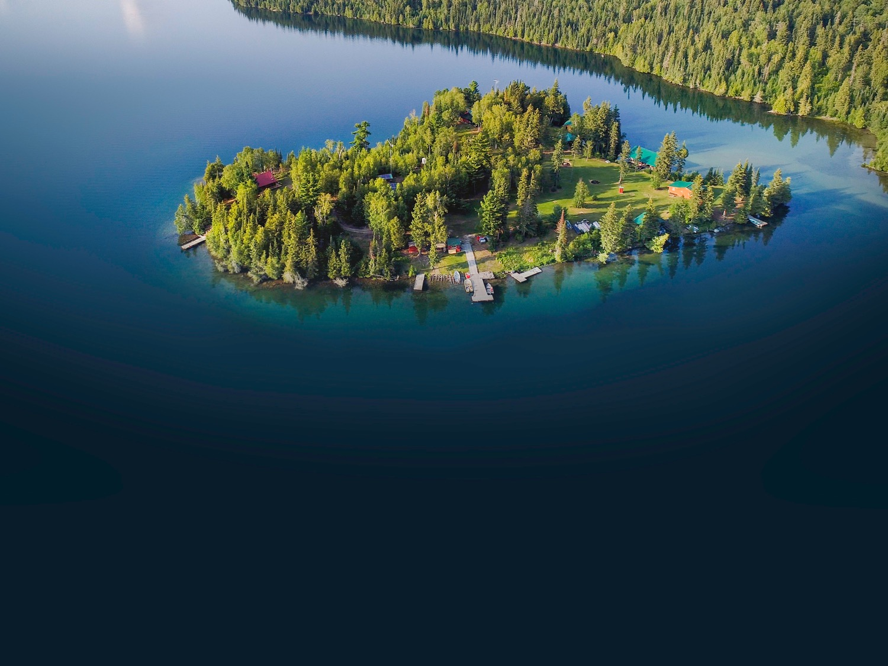



2021 U.S. / CANADA BORDER CLOSURE
Attracting Domestic Tourists to Resource Based Tourism Establishments in Northern Ontario
In light of COVID-19 and the continued closure of the U.S./Canada border, DNO contracted the services of Campbell Consulting to come up with short and long-term considerations to attract domestic travellers to Northern Ontario Resource Based Tourism Operators.
www.destinationnorthernontario.ca

Slide 2
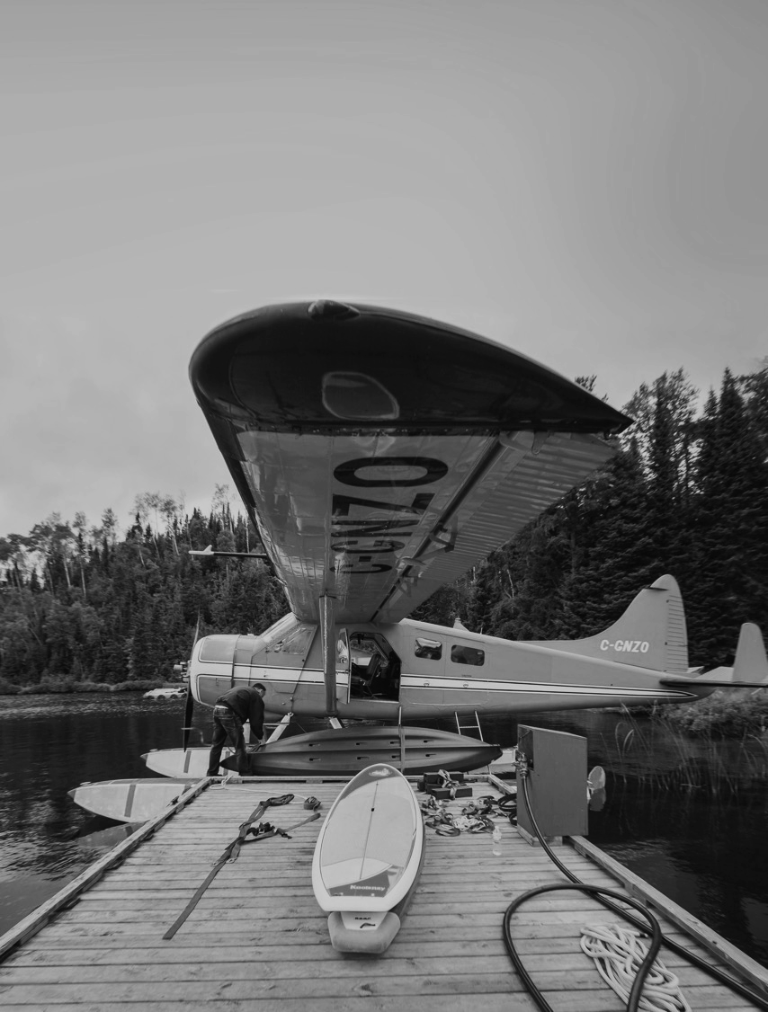

Covid 19 represents the largest economic loss to the tourism industry in Northern Ontario ever!
Tourism operators in Northern Ontario require support from government now more than ever.
COVID-19 has annihilated the resource-based tourism industry in Northern Ontario.
Anticipate several bankrupt operations in 2021.
US/CDN border likely to remain closed for 2021 tourist season.

Slide 3



REGIONAL
TOURISM
ORGANIZATION
(RTO) 13
Who We Are
Over 1,000 tourism operators attract 400,000 people annually to Northern Ontario.
$1.1 BILLION
Total GDP =
EVERY YEAR

Slide 4





Northern Ontario tourist operators spend $1 BILLION on equipment, food, gas, supplies, license fees, salaries annually to keep their doors open to visitors
15,000 Jobs = $700,000,000 labour income
%
Federal tax revenue = $110,000,000
%
Provincial tax revenue = $170,000,000
Municipal tax revenue = $50,000,000
%

Slide 5
1.0
SHORT TERM CONSIDERATION
On November 5, the Province released the 2020 Budget Ontario’s Action Plan: Protect, Support, Recover.
As part of the Budget, the government is setting aside $150 Million for an Ontario Staycation Initiative and is exploring ways to provide Ontario residents with support of up to 20 per cent for eligible tourism expenses to encourage them to discover the province in 2021, when public health experts advise it is safe to do so.
The Ontario Travel Incentive Program will help to build trust and confidence, encouraging Ontarians to explore their local communities – reinvigorating local tourism economies and delivering a much-needed boost to local businesses.
An update on this temporary support measure will be announced at a later date.

Slide 6
1.0
SHORT TERM CONSIDERATION
The Ministry of Heritage, Sport, Tourism and Culture Industries announced the Reconnecting Ontarians: Re-emerging as a Global Leader white paper document in December 2020
http://www.mtc.gov.on.ca/en/Reconnecting_Ontarians.pdf
DNO provided feedback on the contents of the white paper with recommendation to include incentive program for those consumers travelling to northern Ontario. Tiered program – further you travel – larger tax incentive received.

Slide 7
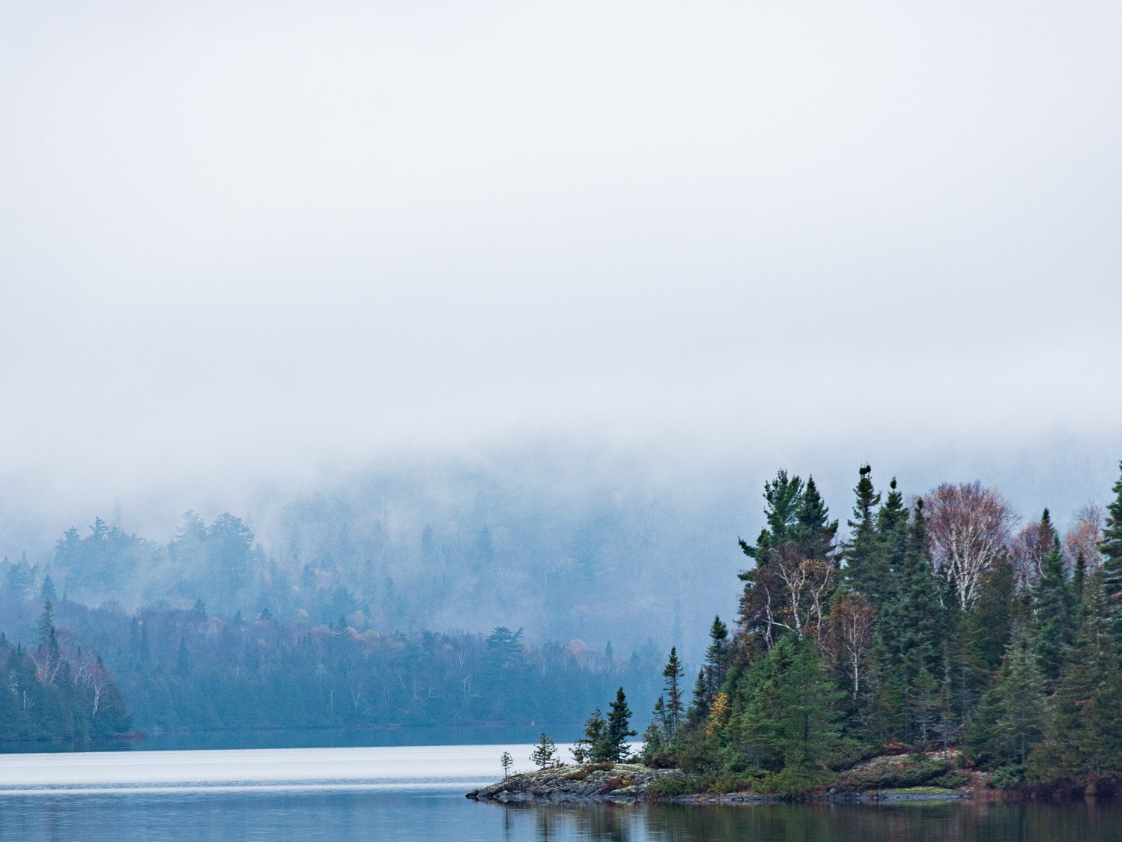
2.0
SHORT TERM CONSIDERATION
Re-Introduce HST Rebate Program for 2021 & 2022 Season
In 2007, the federal government introduced a Tax Refund for US Visitors to Canada, which has since closed. Re-introduce a similar program for domestic visitors traveling in Ontario.
%

Slide 8

1.0
LONG TERM CONSIDERATION
Help to Build a Stronger Nature and Outdoor Tourism Ontario
The resource-based tourism sector in Northern Ontario lacks the resources to support an organization that collectively represents the business interests of the sector to government. Nature & Outdoor Tourism Ontario (NOTO) spends a large portion of their time sourcing out funding opportunities to maintain their existence instead of focusing on the needs of the businesses in this sector.
Over the past 30 years, resource-based tourism operators have seen drastic cuts in resource allocations reducing revenues and new regulations increasing operating costs. Northern Ontario resource based tourism operators requires the assistance of government now more than ever, building capacity within NOTO will create a stronger voice to grow the resource-based tourism industry in Northern Ontario.
NOTO has a long history of providing business supports to resource-based tourism operators. Over the past 90 years NOTO provided support to government through consultation with industry, meaningful dialogue and collaboration in developing policies and regulations that have set the path for the resource-based tourism industry in the North. All of this work to date has been done with resources directly from a portion of the sector itself. In recognition of the need for a strong organization to continue to support a sector that has been severely affected by the pandemic, a path towards long term sustainability needs to be set.

Slide 9


1.0
LONG TERM CONSIDERATION
Help to Build a Stronger Nature and Outdoor Tourism Ontario
+
OPTION
DNO can play a financial role in strengthening NOTO through project-based product development initiatives. Similar to the annual contractual obligations with Domestic Marketing Organizations to market tourism product in the north, NOTO could play a greater role in pan northern product development initiatives.
The intent is to provide long term sustainable project-based funding opportunities to NOTO that will allow the organization to grow, build capacity and better serve the needs of the tourism industry in the north.
NOTO is within year two of a five year strategic plan, as a starting point, DNO & NOTO review strategic priorities to find synergies for implementation.
DNO to review current product development initiatives to determine if NOTO can lead.

Slide 10
2.0
LONG TERM CONSIDERATION
NOHFC Resource Based Tourism Program
Government must empower the recovery and growth of the tourism industry in Northern Ontario by developing a sector specific stand-alone funding program for resource-based tourism businesses.
Federal and Provincial programs exist for agriculture, forestry and mining in Northern Ontario but there is not an exclusive program for the tourism sector.
The last government program to directly assist the resource-based tourism sector was the Resource Based Tourism Diversification Program. The program was created as a result of the spring bear hunt cancellation in 1999 with funding to support operators moving from traditional hunting and fishing vacations to developing eco-tourism vacations. Program prerequisites required operators to declare they would not pursue legal action against the province of Ontario for lost revenue from the cancellation of the spring bear hunt. The program saw less than 100 applications with less than 25 operators receiving funding.
The Northern Ontario Heritage Fund Corporation released new programming February 2021, within the suite of programs are two sector specific programs for film and agriculture in Northern Ontario. This sets precedence supporting a specific sector in Northern Ontario. Why can't they create a program for the Resource-Based Tourism Industry?
Lobby NOHFC to create a grant program providing resource-based tourism operators in Northern Ontario with funding greater than 50%. Tourism operators do not have the financial ability to support the current 50% requirement.

Slide 11

3.0
LONG TERM CONSIDERATION
Branded Long-Term Angling Program
Build a brand around everything angling in Northern Ontario. The brand is to include collaborative programming with the intent of creating organic content that showcases fishing in Northern Ontario on every social platform available to anglers of all ages.
A thorough search was conducted on angling destinations around the world to determine how effective their strategies are to generate content and interest. The destination with the most impactful brand among all platforms is Northern Ontario’s greatest competition – FISH HUNT MB.
The world has changed, anglers have changed, Northern Ontario has to change to maintain and grow their market-share within angling tourism. There is an opportunity for Northern Ontario to be a leader in marketing angling as a destination by building quality content and strategically showcasing across all social media platforms.

Slide 12
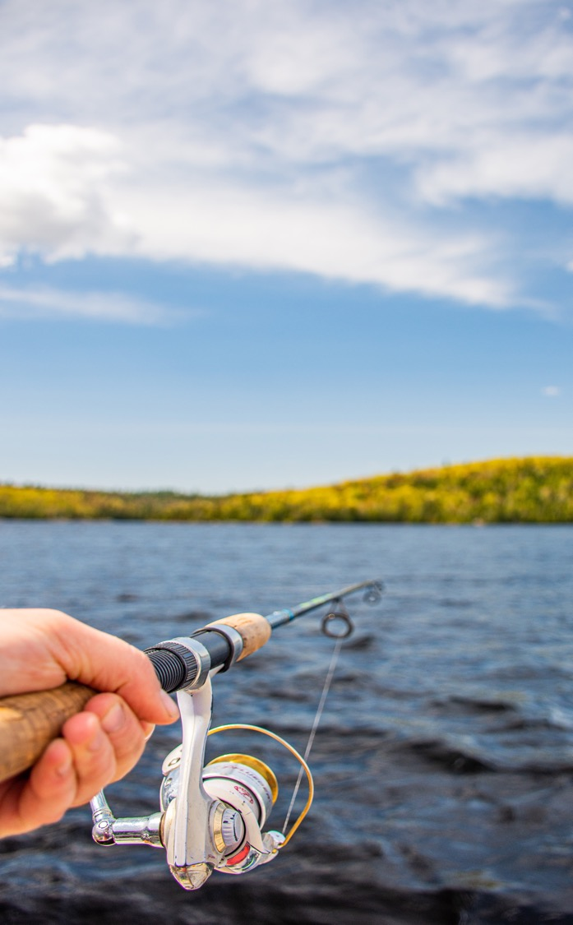
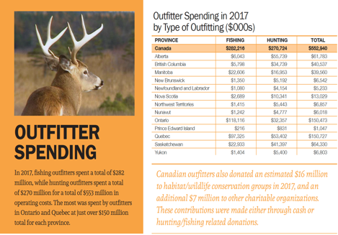
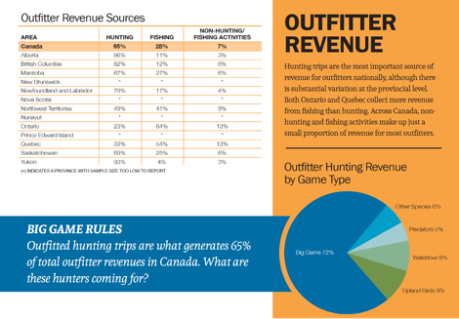
ADDITIONAL INFORMATION
i
Additional
Information
The following information is available for information purposes highlighting the economic impact of resource based tourism throughout Canada.
Source: Canadian Economic Outfitters Associations –
"The Economic Impacts of Outfitting in Canada"

Slide 13


Slide 14
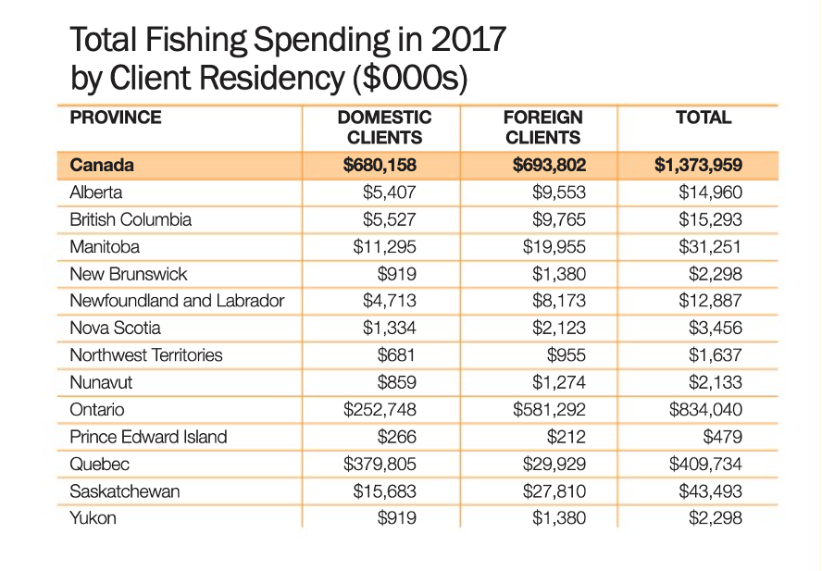


Slide 15
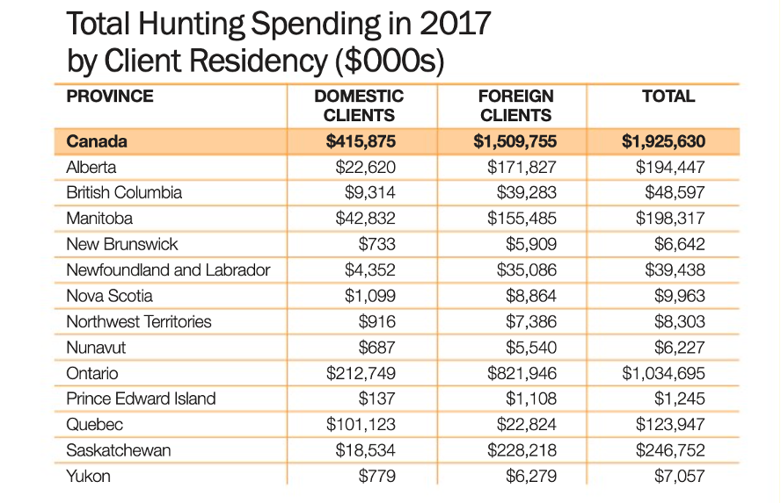

Slide 16
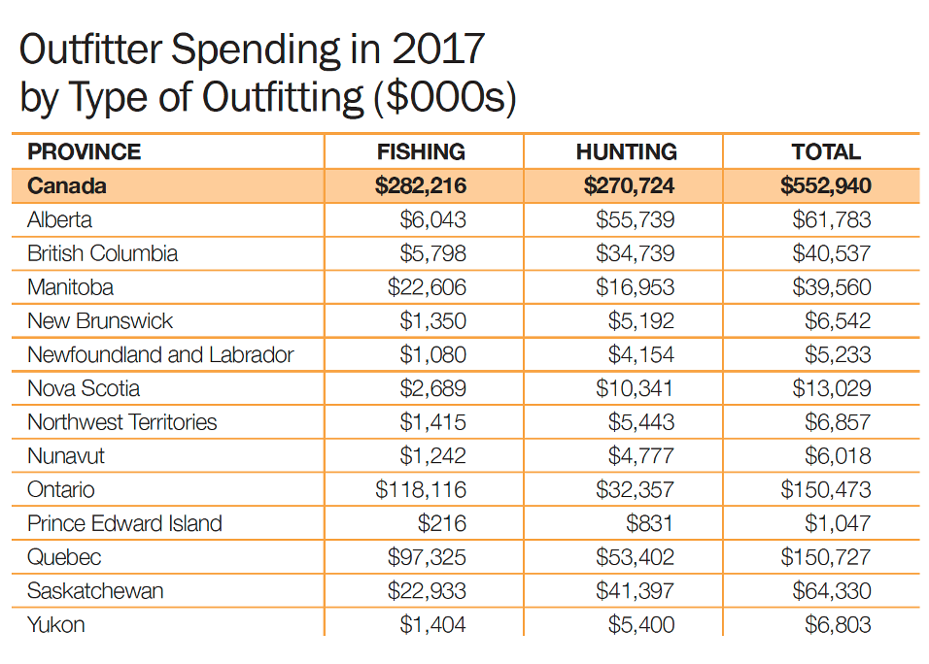

Slide 17
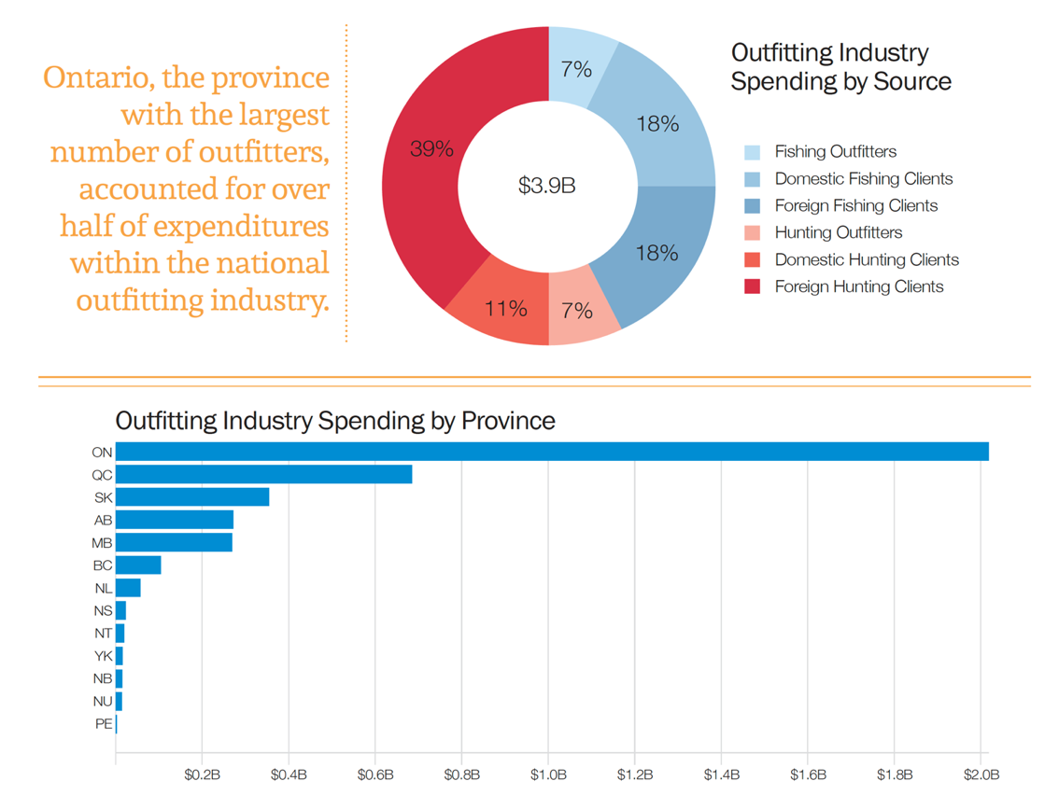

Slide 18
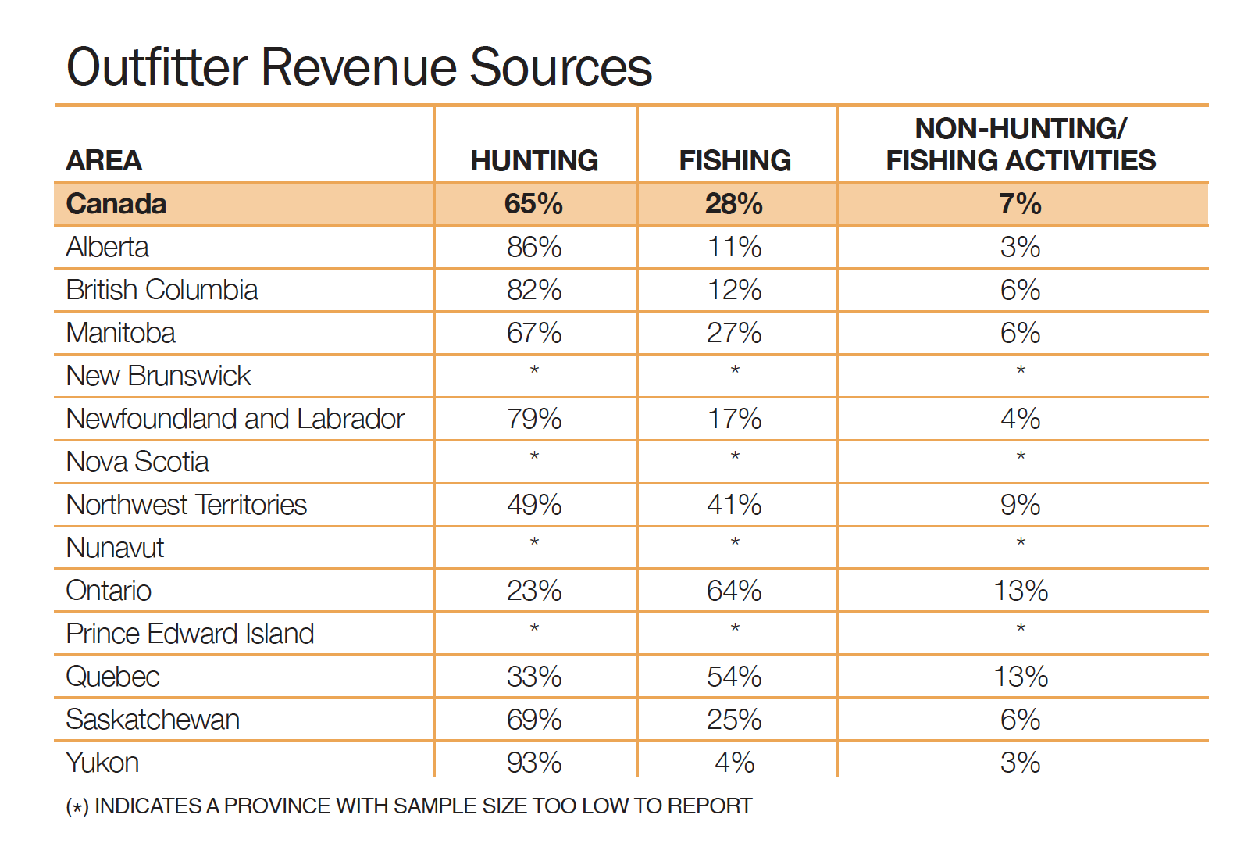

Slide 19
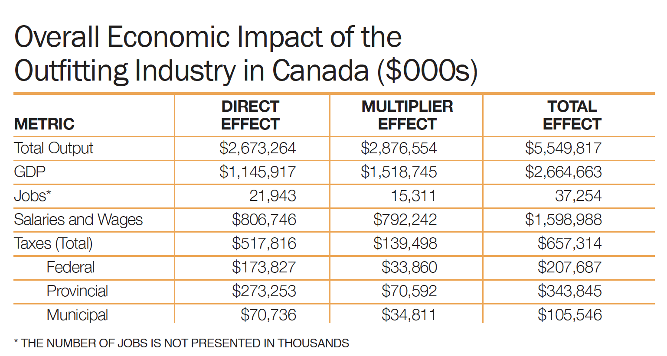

Slide 20
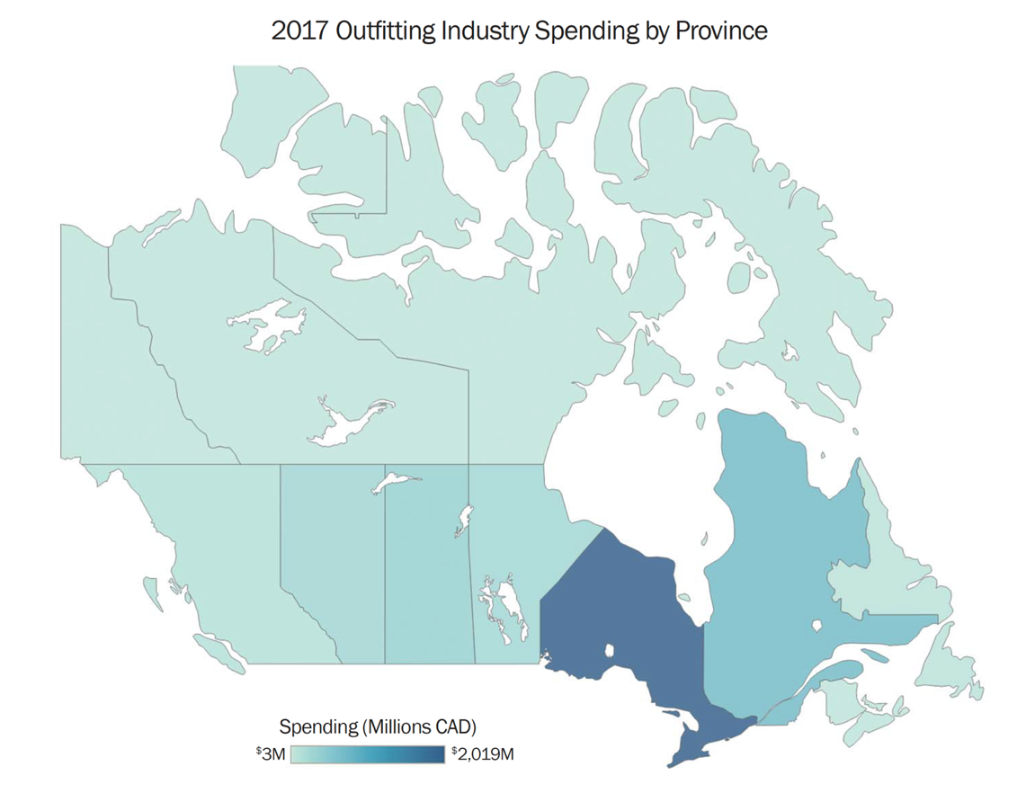

Slide 21
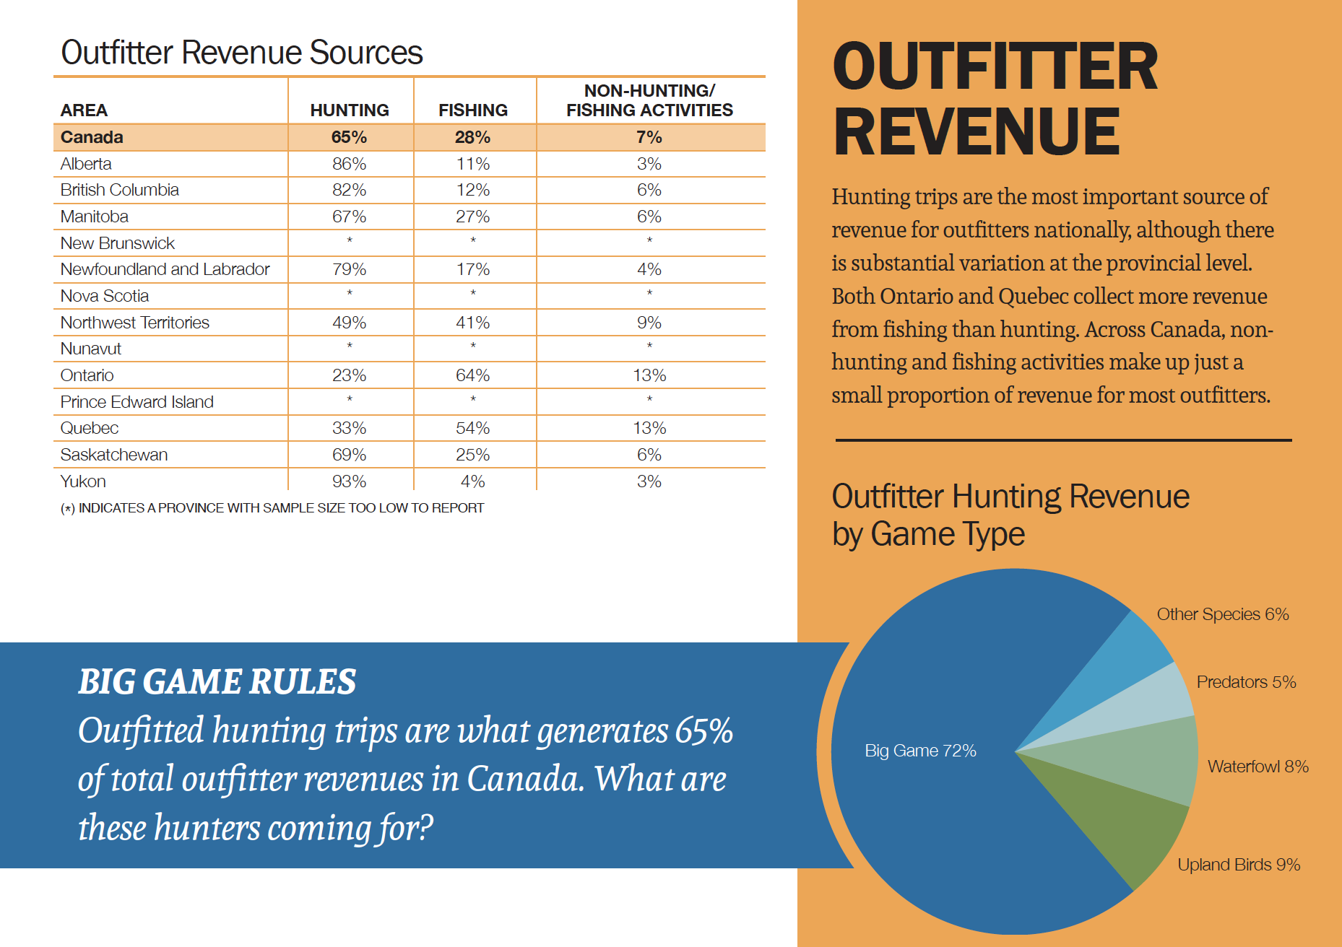

Slide 22

Jim Antler | Ministry of Heritage, Sport, Tourism and Culture Industries
John Guerard | NOHFC
Hailey Berlin | Ministry of Heritage, Sport, Tourism and Culture Industries
Eric Lund | Esnagami Lodge
Betty McGie | Destination Northern Ontario
David MacLachlan | Destination Northern Ontario
Laurie Marcil | NOTO
Julie Summers | Fireside Lodge
Wayne Clark | Clarks Cabins
Meagan Clark | Clarks Cabins
Angelo Viola | Fish ‘n Canada Show
Rob LaRue | Algoma Country
Gerry Cariou | Sunset Country
Emma Jones | Karen Jones Consulting
Stephanie Hopkin | Destination Northern Ontario
Sara Dekker | Destination Northern Ontario
Heather Chertow | MNDME
Jacqueline LaRocque | Northwestern Ontario Air Charters Association
Beth Potter | TIAO
Sue Crane | Crane’s Lochaven Lodge
Dean Lapham | Redwood Sportfishing Charters
Ted Putnam | Hawk Lake Lodge
Mike Brazeau | Horwood Lake Lodge
Denis Perrier | Cache Campground
Jay Seimens | Thrive Visuals & Youtube Angler
Jayden Symonds | Northwest Outfitters
Consultations

